Slide 1
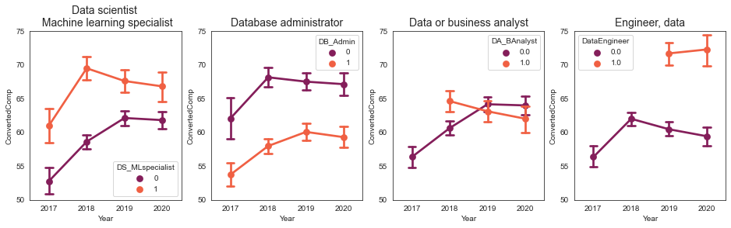
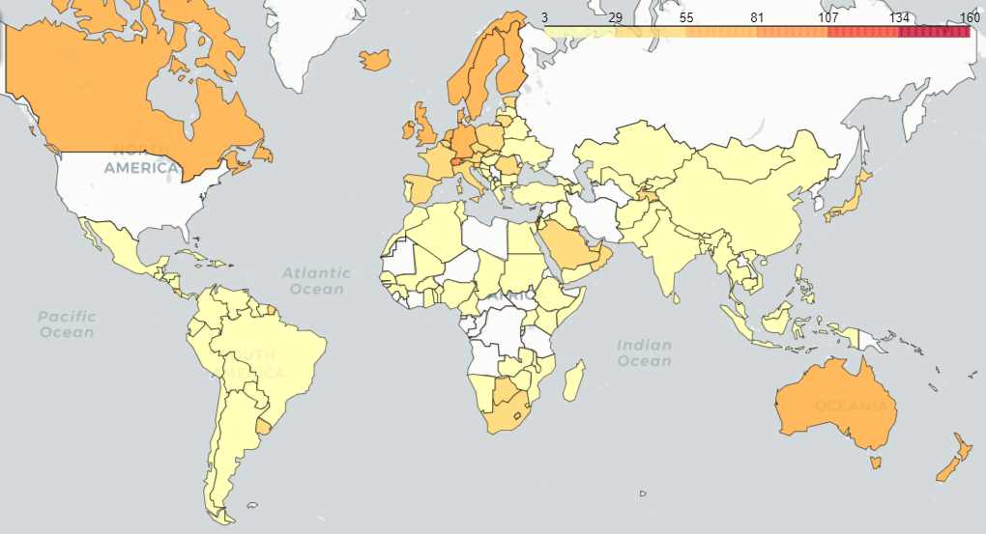
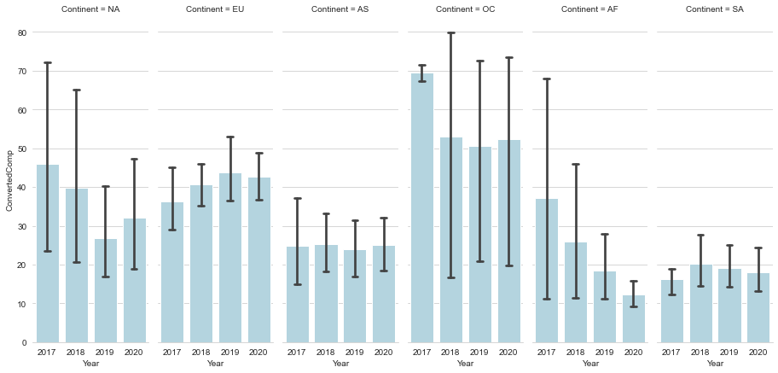
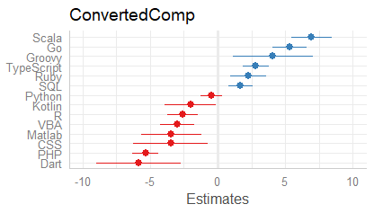
MDSAA – Statistic for Data Science project
Group members
ELEMENTS AFFECTING THE SALARY OF THE SEXIEST ROLE OF 21 CENTURY, DATA SCIENTIST
M
M
M
M
Our problem
What is the impact of education major on salary
Martha
How different job titles
impacted salary?
Comments
Barplot with all
Comments
Annual Salary (k$) ~ | Coefficients | S.E
Business | 8.351 | 1.615
Maths & Stats | 7.214 | 1.476
Another engineering | 5.089 | 1.401
Computer.science | 2.540 | 1.261
~ Annual Salary (k$) | Coefficients | S.E
Data Scientist / ML Specialist | 2.876 | 0.409
Database Administrator | -3.092 | 0.475
Data /Business Analyst | -1.141 | 0.427
Data Engineer | 4.061 | 0.524
Because the increasing demand for data specialists, many individuals high compensation for performing jobs in this field. Thus we decided to evaluate the impact of diferent variables on the expected salary.
- Info about the dataset, sustain higher demand for data scientists, about the variables
Methodology
Salary of data jobs in the world
.
- Info about the dataset, sustain higher demand for data scientists, about the variables
What is the impact of Year of Experience on salary
Natalia
Comments
Bar plot and comment
Education level
Clusters
Comments on profiling / heatmap
Organization size
Comments
Bar plot etc
What is the impact of programming language on salary
Mayu
Conclusion
Comments on the graph and python

